Slide 1




KJSIT-IET INTECH 2K23 National Level Poster cum Project Competition
Academic Year 2022-23
<<FARM WEB>>
KHUSHI PATEL
VINAY SANEPARA
PRAJAKTA BUGADE
(Second Year Engineering)

Slide 2
OUTLINE OF PRESENTATION
Introduction
Summary / Finding of Literature Survey
System Design & Architecture
Proposed Methodology( Algorithm / Flowchart etc)
Video & Audio demonstration of Running Project(5Mins)
Results
Conclusion
References
KJSIT-IET INTECH 2K23 National Level Poster cum Project Competition

Slide 3
INTRODUCTION
Agriculture is known as skill of cultivating plant or crops. A large population in our nation majorly
depends on farming to satisfy their daily needs. Our Indian farming system has been increased with many new technologies to produce maximum farm products and globally India offered with the second
position. In today’s world, or any item to reach from the farmer to the consumer involves a lot of steps
and middlemen which can cause the process to slow down and also cause hoarding of prices where only the farmer and consumer are at a loss. Hence, there is a need for a platform that will help the authorities keep a track of the trade, and take down any such hoarding practices being performed at any stage.
Our idea is to create such a web-based platform for the farmers connecting them directly to the consumers and workers thus expanding their business. This platform will allow these stakeholders to interact with each other and will facilitate the hiring of labour and purchase and sale of raw materials and produce respectively. We provide technology and services to the farmers, merchants, and farm laborers, thus providing them with a wider great experience with an easy-to-use application.
KJSIT-IET INTECH 2K23 National Level Poster cum Project Competition

Slide 4
SUMMARY/ FINDING OF LITERATURE
From the analysis and research, we get to know there are some e-farming websites are there and they are not userfriendly. It is a B2B (business to business) application which any seller can sell the product which may be not a branded or genuine. Farmer didn't, have any idea about the product and buy it, which cause the farmer to cause losses. To avoid this we have come up with a new idea which is B2C (business to customer). Where admin will add a branded product directly from the company and farmer buy it through this we can avoid farmer getting losses. Some Farmer didn't have proper knowledge about the pesticides, fertilizers, seeds and irrigation tools. So our web app helps the farmer to select the right product and genuine product.
Review of similar systems is made and the strength and weaknesses are identified. The similarities between
the reviewed systems and the proposed system are outlined as well as the differences. There are various
android applications and web sites which are international and state wise but not for locality.
There are various surveys and also feedbacks with technologies are reviewed from existing papers and
portal that are listed in the literature survey.
KJSIT-IET INTECH 2K23 National Level Poster cum Project Competition

Slide 5
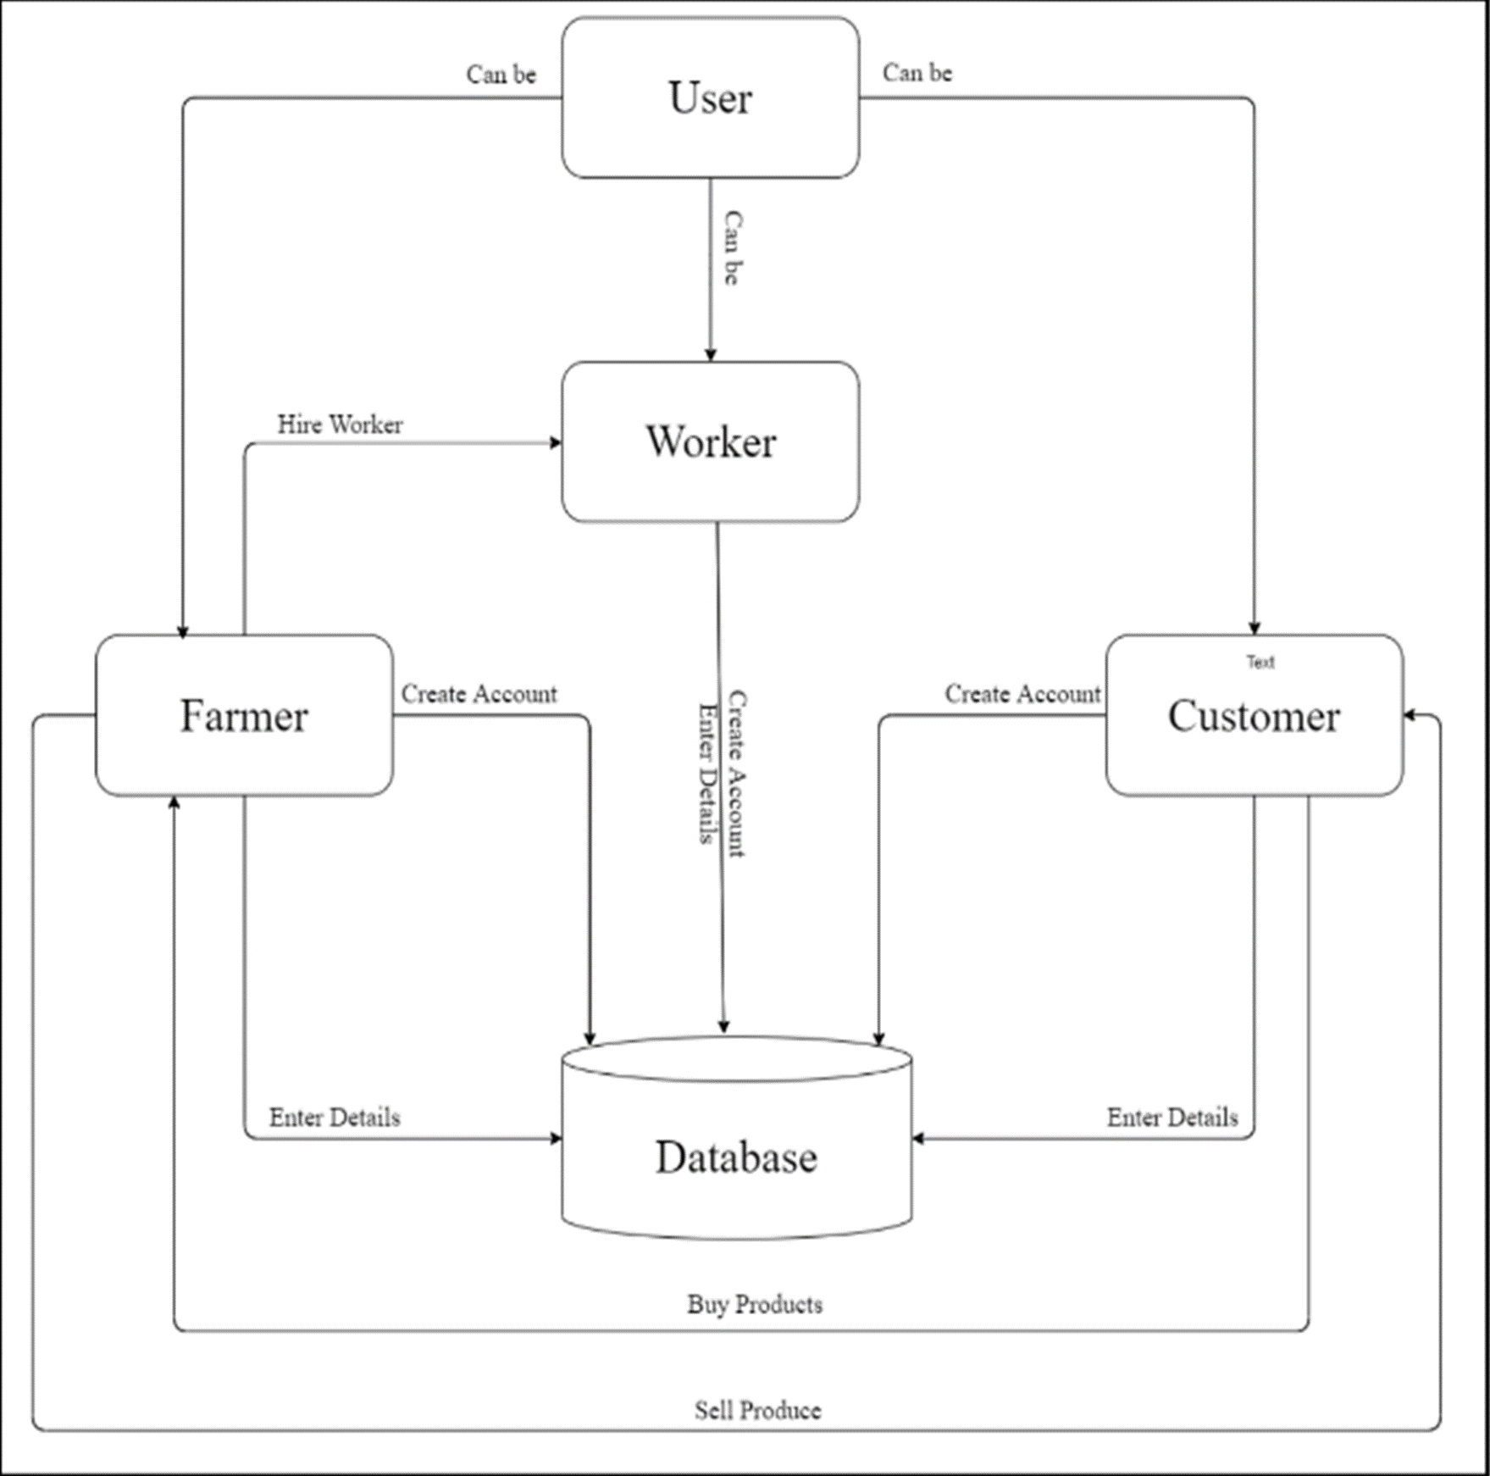
SYSTEM DESIGN & ARCHITECTURE
KJSIT-IET INTECH 2K23 National Level Poster cum Project Competition

Slide 6
PROPOSED METHODOLOGY
The Farm Web will be a web-based application for the farmers. The purpose of this system is to simplify and automate most of the work of farmers.Using this application, farmer can directly connect with the consumers without the involvement of middleman, thus eliminating the middleman commission and hoarding of price. They can also keep an online inventory of their produce, thus avoiding the risks of maintaining a paper log.
❖ Farmer Dashboard: This module will be for the farmers to register themselves and use. Once,they register, they can login to avail various features built for them.
❖ Customer Dashboard: This module will be for the farmers to register themselves and use. The customers will also be equipped with a list of built-in functionalities.
❖ Worker Dashboard: This module will be for the workers to register themselves. The workers or people in search of job in agricultural sector can use this application to let farmers know that they are available for labour hire. The farmers will be shown a list of available workers from this list of registered workers based on the salary expectations of the worker. The user can upload their biodata to let farmers know about their skills and other details.
KJSIT-IET INTECH 2K23 National Level Poster cum Project Competition

Slide 7
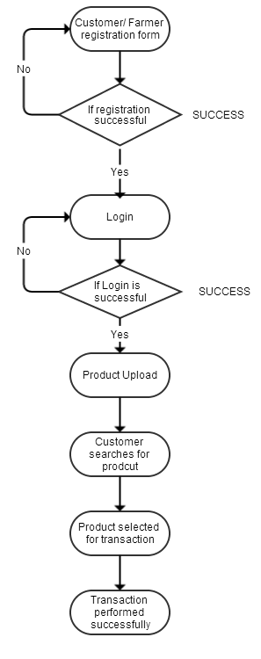
PROPOSED METHODOLOGY (CONTD)
KJSIT-IET INTECH 2K23 National Level Poster cum Project Competition

Slide 8
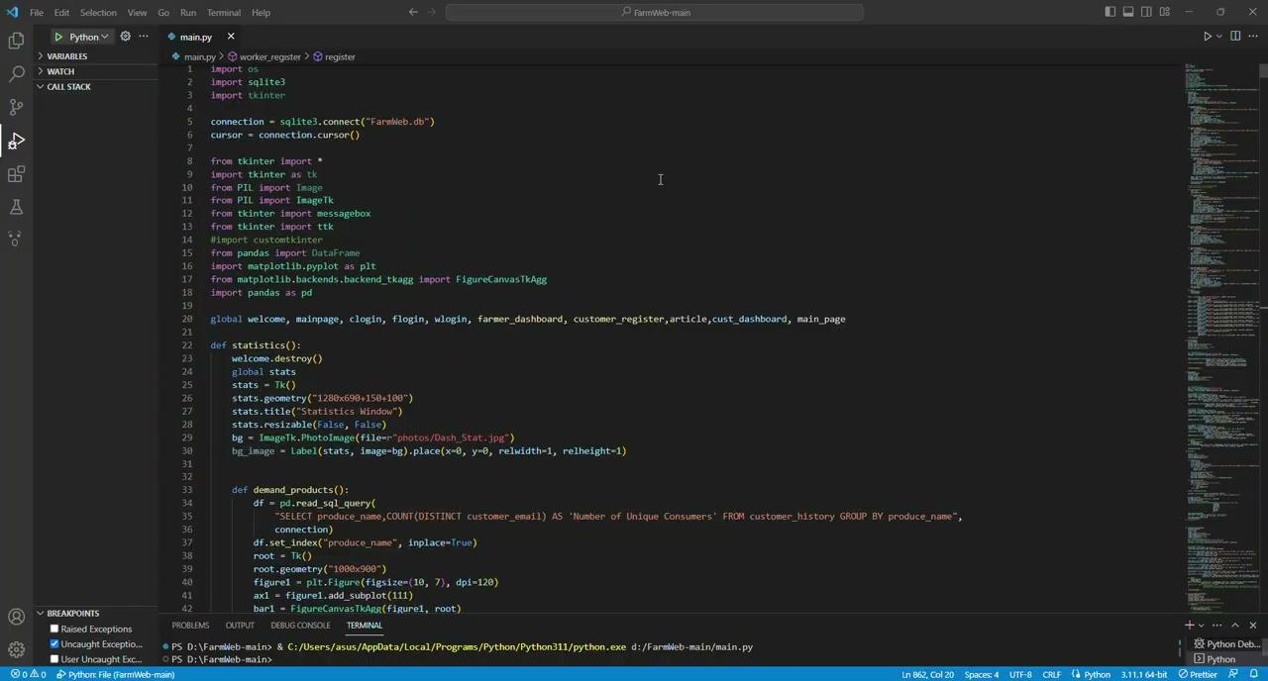
VIDEO DEMONSTRATION OF RUNNING PROJECT
KJSIT-IET INTECH 2K23 National Level Poster cum Project Competition

Slide 9
RESULTS
Farm applications can have significant benefits for farmers, including improved productivity, efficiency, and sustainability. By using precision agriculture, farm management systems, livestock management technology, agricultural robotics and sensors farmers can make data-driven decisions and optimize their operations. These technologies can help farmers save time and money, reduce waste, and produce higher yields while minimizing their environmental impact.
Farm management systems are software applications that help farmers manage their operations more efficiently by providing insights and analytics on crops, and other factors.
Overall, farm application has the potential to significantly improve farming practices and increase productivity while also promoting sustainability and reducing environmental impact.
KJSIT-IET INTECH 2K23 National Level Poster cum Project Competition

Slide 10
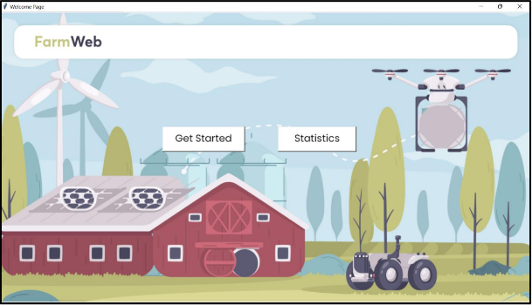
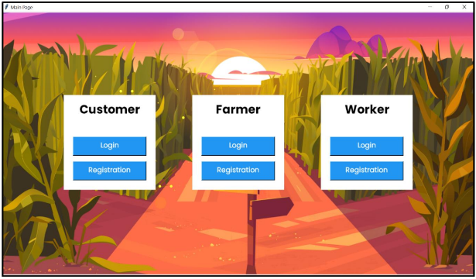
RESULTS
KJSIT-IET INTECH 2K23 National Level Poster cum Project Competition

Slide 11
CONCLUSION
Our application helps to provide the hardworking farmers of our country the business and clients that
they need and most of all, deserve.It helps the wholesalers and retailers in buying products directly from a
large number of farmers. Thereby, it enables the wholesalers and retailers in expanding their business. It
features online shopping for fertilizers, pesticides, machinery & tools, etc. It enables farmers to hire
labourers, which in turn, will help the farm labourers to find small jobs by having a work profile on the
website. In modern world, where everyone has a smartphone to use, a web-based application will
surely aid the farmers.This Project will thus pave the way for an efficient means to carry out the buying and
selling of the products. Also, the system is completely online (webapp/app) thereby reducing the price aspect
of the system tremendously.This system is proposed to replace the existing system where the farmer has to
suffer between the manufacturers and the traders.
KJSIT-IET INTECH 2K23 National Level Poster cum Project Competition

Slide 12
REFERENCES
https://youtube.com/playlist?list=PLsyeobzWxl7poL9JTVyndKe62ieoN-MZ3
https://youtu.be/WDEyt2VHpj4
https://www.freeprojectz.com/python-django-project/farm-management-system
KJSIT-IET INTECH 2K23 National Level Poster cum Project Competition

